Slide 1

William Roberts CIS216 Task5 Prof Stephen Leggett

Slide 2
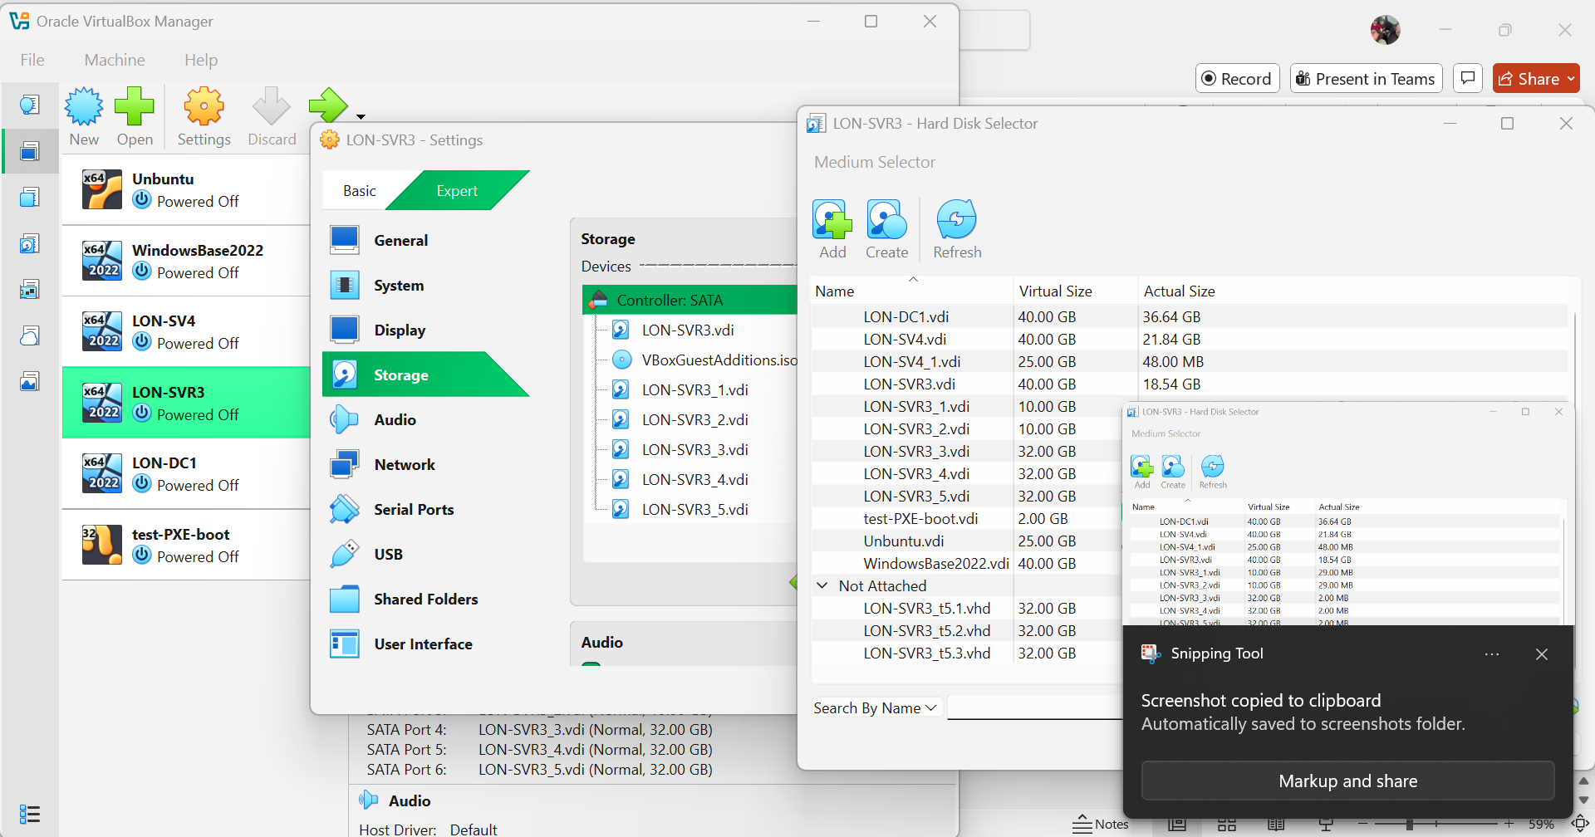
Create a Storage Pool and a Storage Space

Slide 3
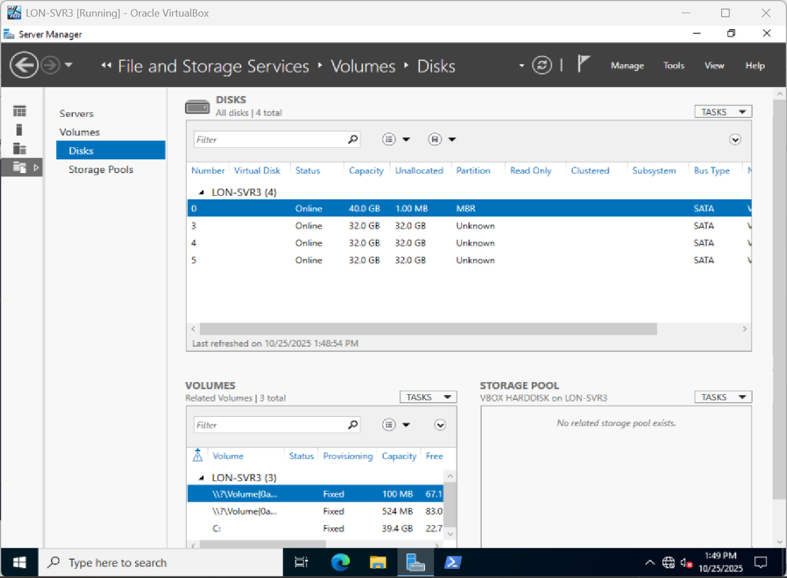
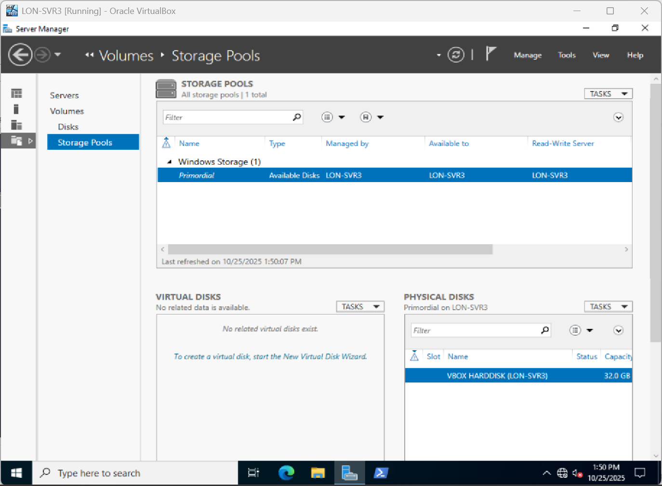
File and Storage Services
Shows the disks added but when I go to storage pools only shows the one disk

Slide 4
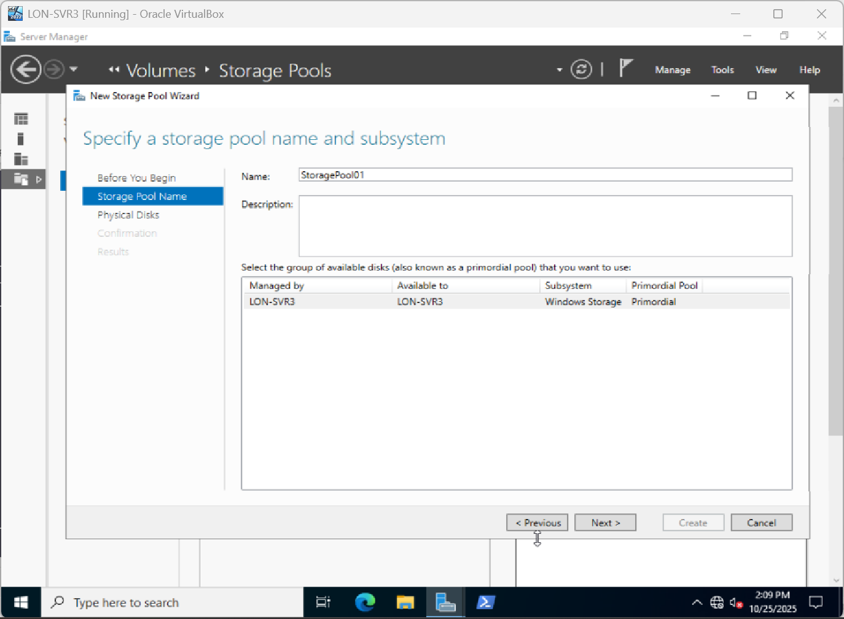
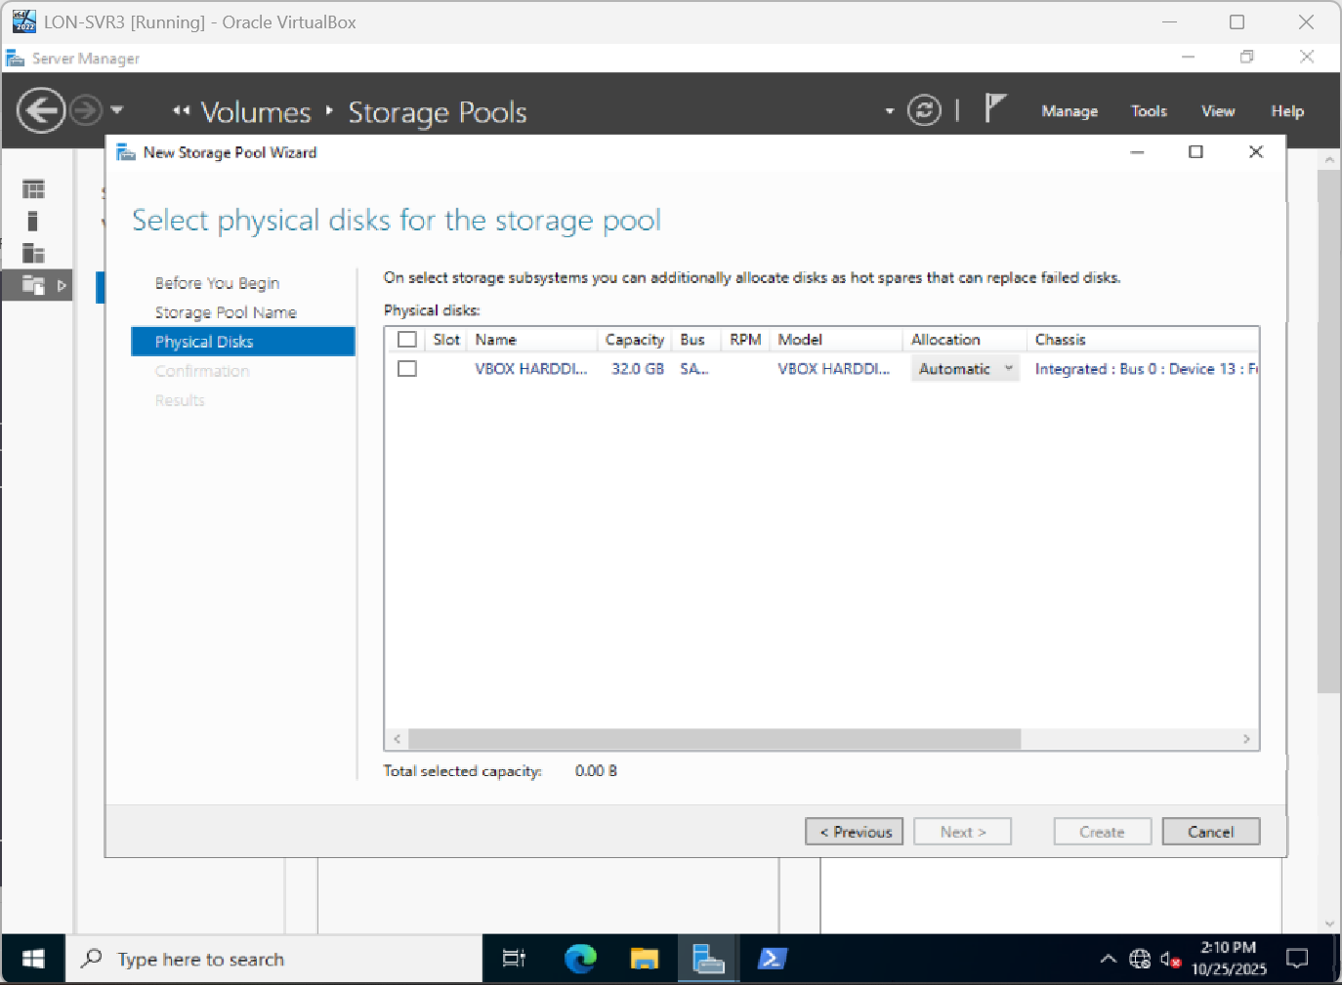
Create Primordial pool New Storage Pool
Named
Only one Disk Showing

Slide 5
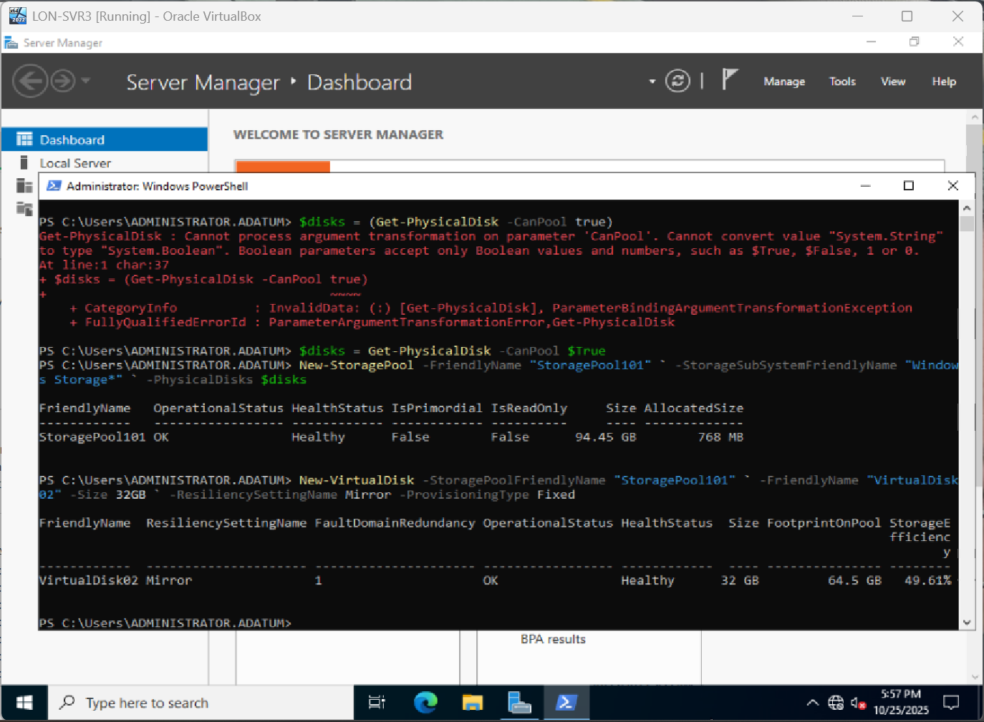
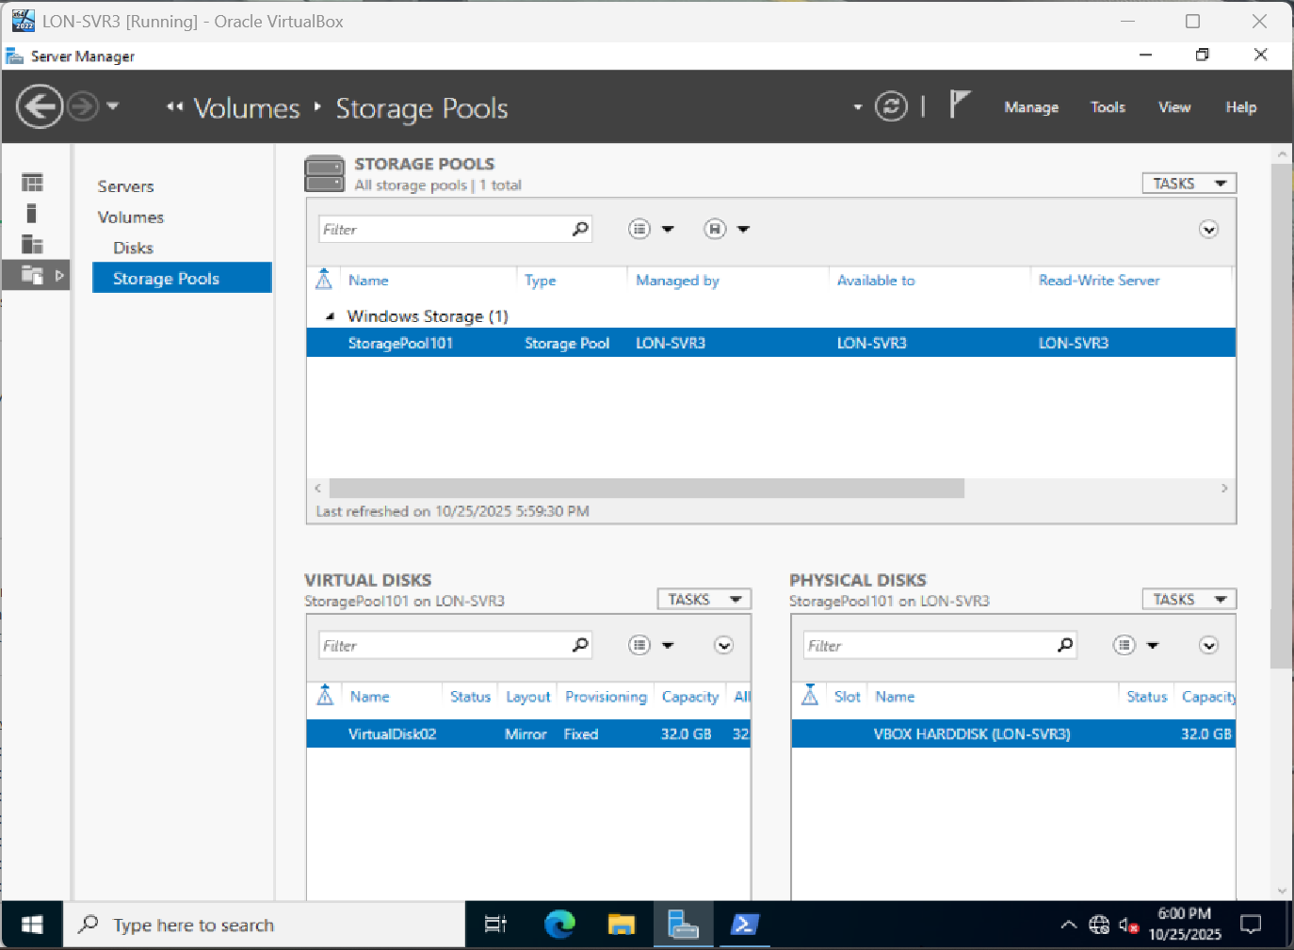
Help from Oscar using PowerShell I was able to get this done

Slide 6
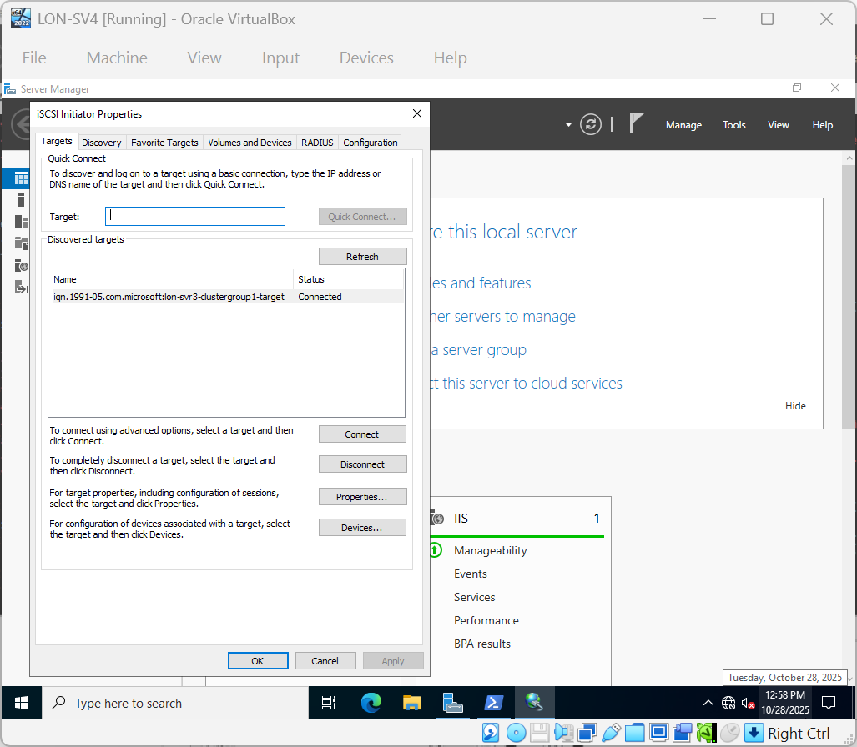
Added iSCSI Services

Slide 7
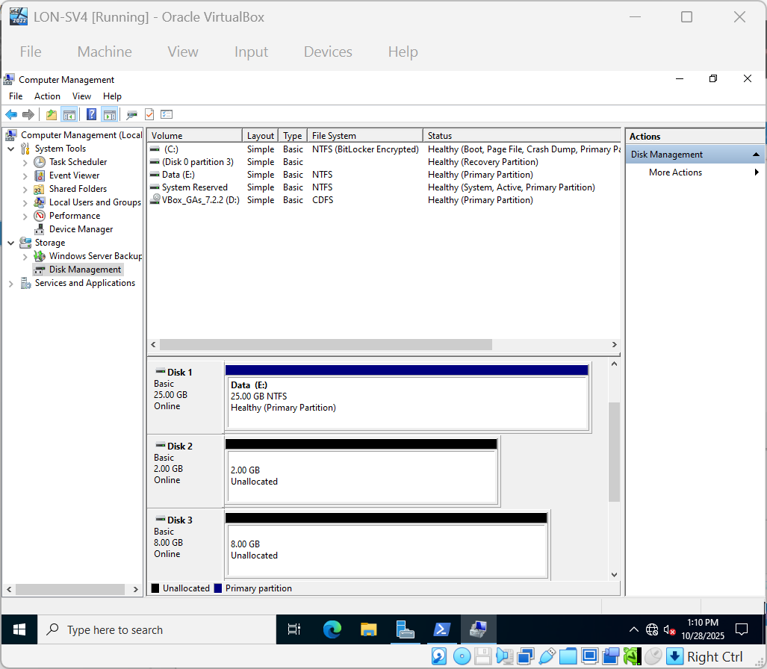
New iSCSI Virtual Disk

Slide 8
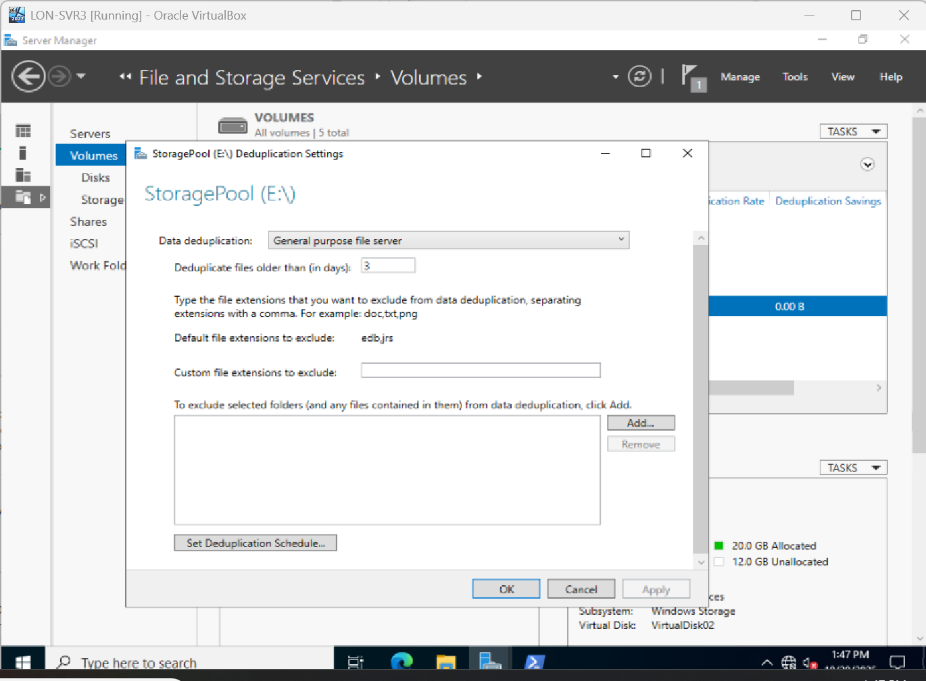
Configure Data Deduplication

